Slide 1
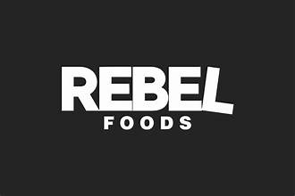
Rebel Foods
Rebel Foods is an Indian online restaurant company which operates 11cloud kitchen brands including Faasos, Behrouz Biryani and Oven Story. It is the largest cloud kitchen restaurant chain in the world, operating more than 450 cloud kitchens in 10 countries.

Slide 2




Rebel Foods - Founders and Team
The following members are the key people of Rebel Foods:
Jaydeep Barman is the co-founder and the CEO of Rebel Foods
Kallol Banerjee is a co-founder at Rebel Foods.
Ravi Golani has been a part of Rebel Foods since 2015

Slide 3
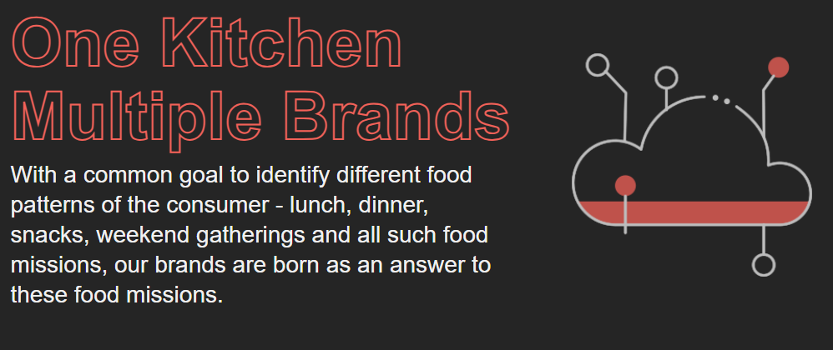
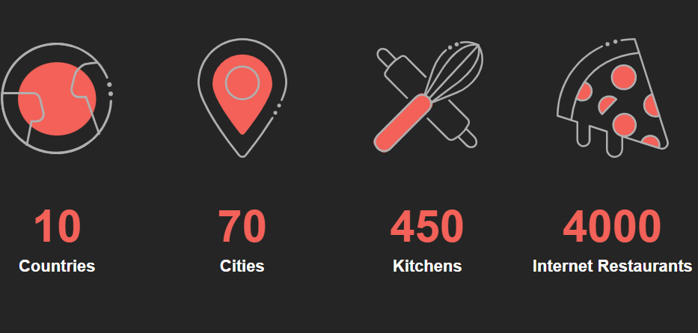
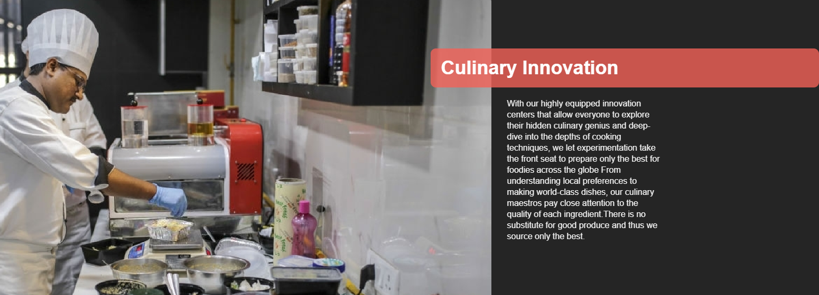
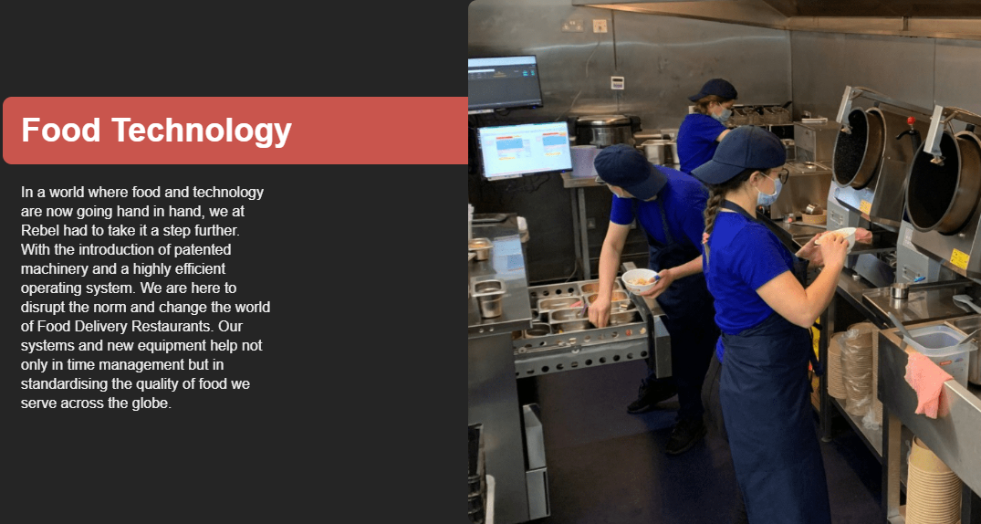
What does Rebel Foods do?

Slide 4
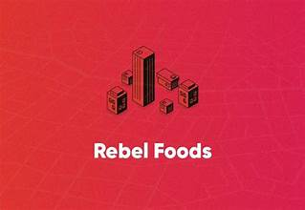
Porter's Five Forces Analysis for Rebel Food
1. Threat of New Entrants
High: The food delivery industry has low barriers to entry, with relatively low capital requirements and technological advancements making it easier for new players to enter the market. This increases competition and puts pressure on existing players like Rebel Food.
2. Bargaining Power of Suppliers
Moderate: Rebel Food relies on restaurants and cloud kitchens as suppliers. While there are numerous suppliers, the bargaining power can vary depending on the restaurant's popularity and exclusivity. Additionally, the reliance on delivery partners can also influence supplier bargaining power.
3. Bargaining Power of Buyers
High: Customers in the food delivery industry have a wide range of choices and can easily switch between platforms. This gives customers significant bargaining power in terms of pricing, promotions, and service quality.
5. Rivalry Among Existing Competitors
High: The food delivery industry is highly competitive with numerous players, including established giants and new entrants. This intense rivalry leads to price wars, promotions, and a focus on customer acquisition and retention.
4. Threat of Substitute Products or Services
High: Customers can choose to order food directly from restaurants, cook at home, or opt for other delivery services. This presents a significant threat of substitution for Rebel Food.

Slide 5

Rebel Foods: A SWOT Analysis
STRENGTHS:
Strong Brand Portfolio: Rebel Foods boasts a diverse range of food brands catering to different customer segments.
Scalability: The cloud kitchen model allows for rapid expansion and scalability across various locations.
Technology Focus: The company’s emphasis on technology for operations, marketing, and customer engagement is a significant strength.
Cost Efficiency: The cloud kitchen model inherently leads to lower operational costs compared to traditional restaurants.
Data-Driven Approach: Rebel Foods likely leverages data analytics to optimize menu offerings, pricing, and marketing strategies.
Weaknesses
Dependence on Food Delivery Platforms: Reliance on platforms like Zomato and Swiggy for customer reach can be a double-edged sword.
Competition: The cloud kitchen industry is highly competitive with numerous players entering the market.
Food Safety Concerns: Maintaining consistent food quality and safety standards across multiple kitchens can be challenging.
Brand Dilution: Managing multiple brands effectively to avoid brand dilution can be complex.
Opportunities
Market Expansion: Expanding into new geographic markets and tapping into untapped customer segments.
Product Diversification: Introducing new food categories or cuisines to broaden the customer base.
Partnerships: Collaborating with complementary businesses (e.g., grocery delivery) to create new revenue streams.
Technology Innovation: Continuously investing in technology to improve operational efficiency and customer experience.
Threats
Economic Downturns: Economic fluctuations can impact consumer spending on food delivery.
Rising Input Costs: Increases in food and labor costs can erode profit margins.
Regulatory Challenges: Changes in food safety regulations or licensing requirements can impact operations.
Changing Consumer Preferences: Evolving tastes and dietary trends can affect demand for certain food items.

Slide 6
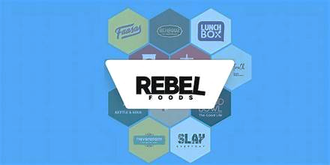
Product Life Cycle Analysis for Rebel Foods
Introduction
Rebel Foods started with a few select brands and focused on building its online platform and establishing its cloud kitchen infrastructure. It introduced innovative menu options and promoted its unique selling points to gain initial traction in the market.
Growth
Rebel Foods experienced rapid growth by expanding its product portfolio, increasing its cloud kitchen network, and leveraging digital marketing strategies. It captured a significant market share and established itself as a leading player in the foodtech industry.
Maturity
As the market matures, Rebel Foods focuses on maintaining its growth trajectory, optimizing its operations, and fostering customer loyalty. It continues to innovate and diversify its offerings, exploring new product categories and market segments.
Decline (Potential)
While Rebel Foods is currently experiencing growth, potential factors like increased competition, changing consumer preferences, or economic downturns could lead to a decline in the future. It's important for Rebel Foods to stay agile and adapt to market dynamics.

Slide 7
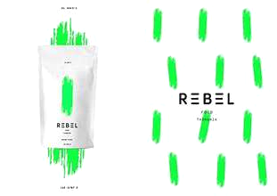
The 3 C's Framework for Rebel Foods
Rebel Foods targets a diverse customer base with varying dietary needs and preferences, including young professionals, students, families, and health-conscious individuals. It caters to different lifestyles and offers a wide range of cuisines and meal options to cater to customer preferences.
Customer
Rebel Foods faces competition from established food delivery platforms, traditional restaurants, and emerging foodtech startups. It differentiates itself through its focus on quality ingredients, unique culinary offerings, and efficient delivery services.
Competitor
Rebel Foods is known for its innovative business model, efficient cloud kitchen infrastructure, and strong brand identity. It leverages technology and data analytics to enhance customer experience and optimize its operations.
Company

Slide 8

Marketing Mix Model Application for Rebel Foods
Product
Rebel Foods offers a wide range of food products, catering to diverse tastes and dietary needs. It focuses on innovative menu items, customized meal plans, and efficient delivery services.
Price
Rebel Foods strategically positions its pricing to be competitive while maintaining profitability. It utilizes various pricing strategies, including value pricing, promotional pricing, and tiered pricing, to attract different customer segments.
Price
Rebel Foods strategically positions its pricing to be competitive while maintaining profitability. It utilizes various pricing strategies, including value pricing, promotional pricing, and tiered pricing, to attract different customer segments.
Promotion
Rebel Foods employs a comprehensive marketing strategy, incorporating digital marketing campaigns, social media engagement, influencer collaborations, and targeted promotions to reach its target audience. It leverages data analytics and consumer insights to optimize its marketing efforts.

Slide 9
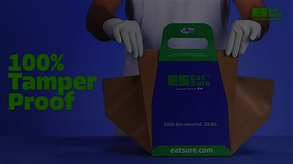
PESTLE Analysis for Rebel Foods
Social
Changing consumer preferences towards convenience, healthier eating habits, and personalized food experiences present both opportunities and challenges for Rebel Foods. Growing awareness of food sustainability and ethical sourcing also influences consumer choices
Economic
Economic factors such as inflation, consumer spending patterns, and disposable income levels directly influence Rebel Foods' business. Fluctuations in these factors can affect consumer demand for food delivery services.
Political
Government regulations on food safety, delivery services, and online platforms have a significant impact on Rebel Foods. Government initiatives supporting food startups and digitalization can also create opportunities for growth.

Slide 10
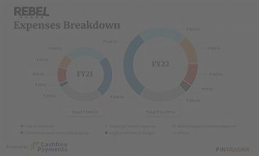
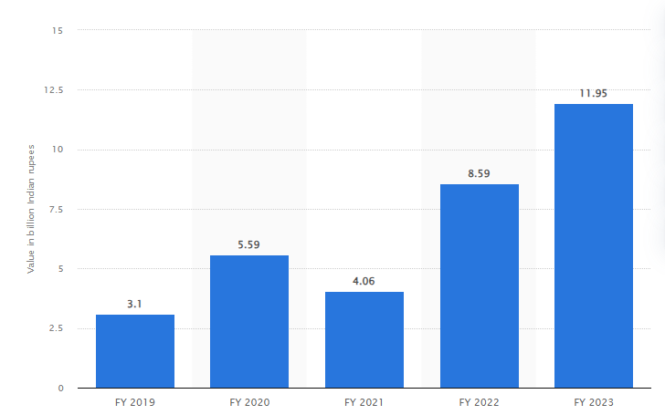
Rebel Foods revenue (2019-2023)
Rebel Foods Private Limited recorded a revenue of about 11.95 billion Indian rupees in the financial year 2023. The revenue increased in comparison to the previous year. Rebel Foods is a quick-service restaurant chain that operates 11 cloud kitchens. Headquartered in Mumbai, India, it owns brands like Faasos, Behrouz Biryani, and Mandarin Oak amongst others.

Slide 11
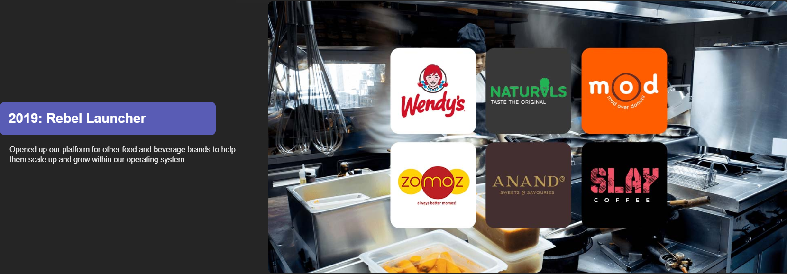
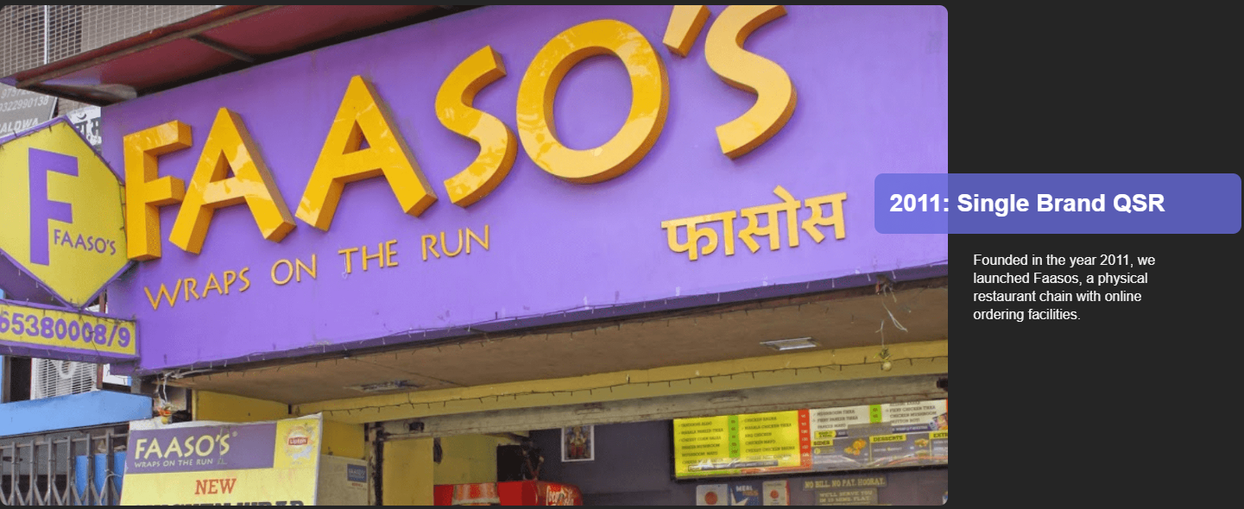
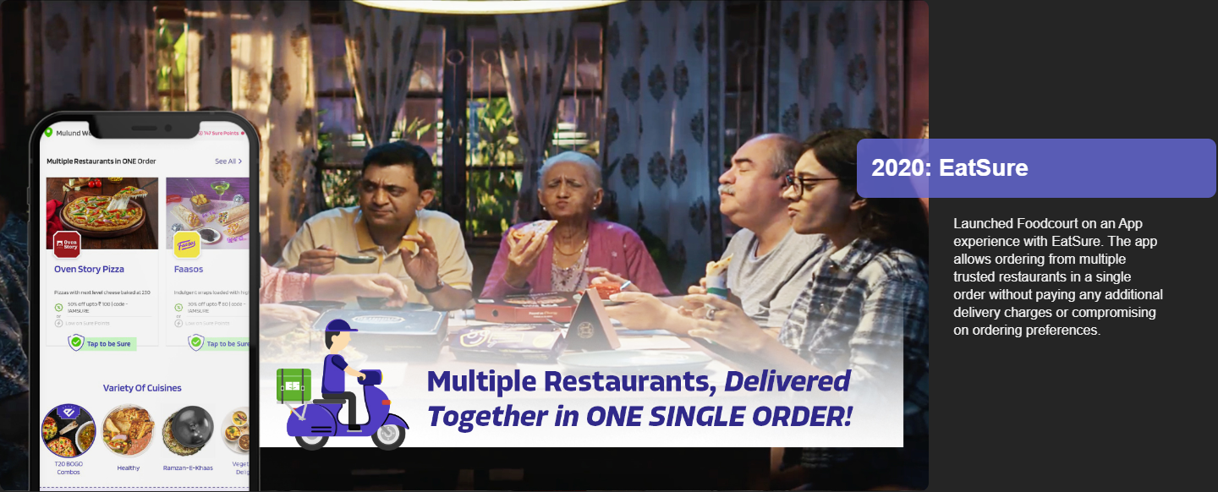
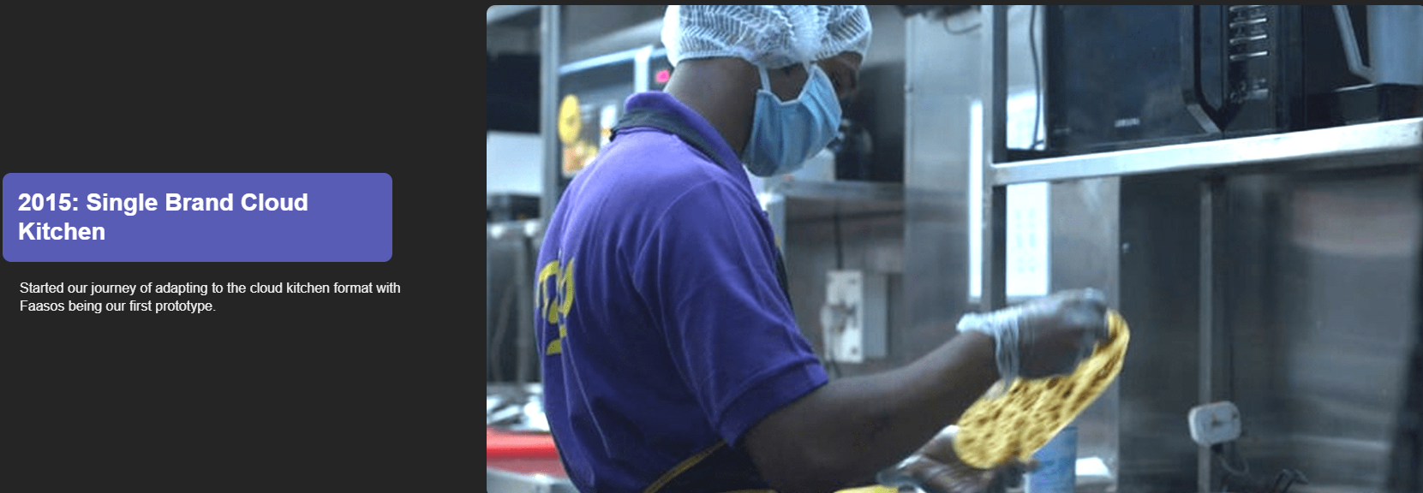
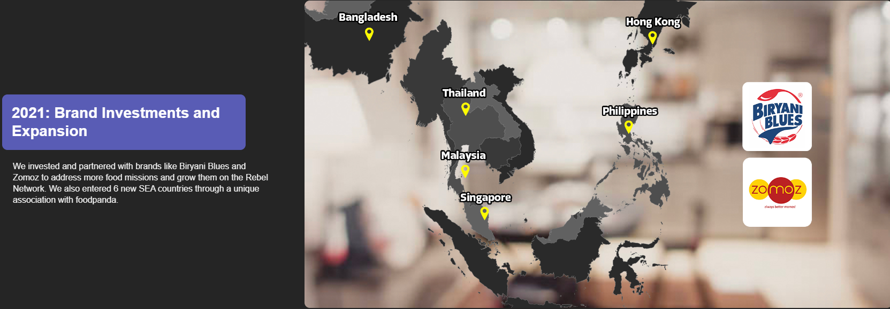
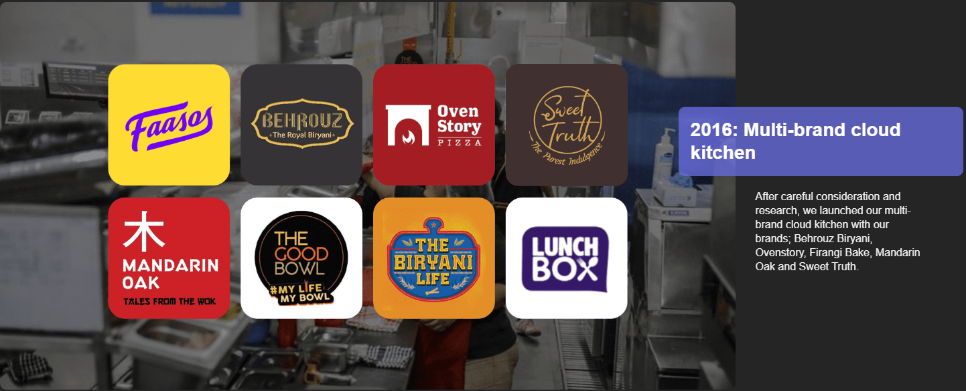

Slide 12
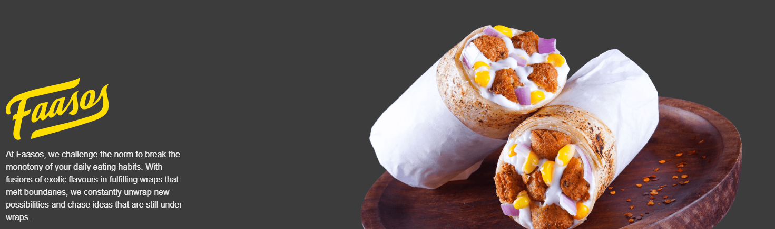
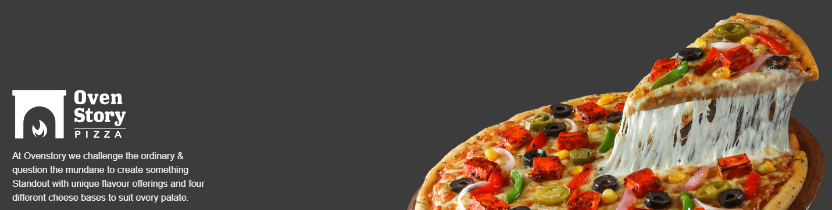
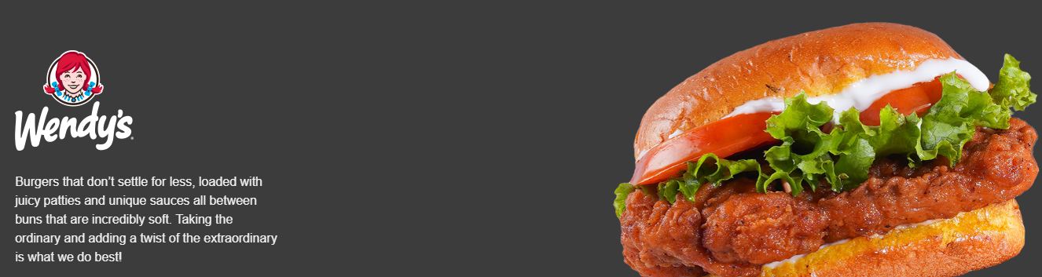
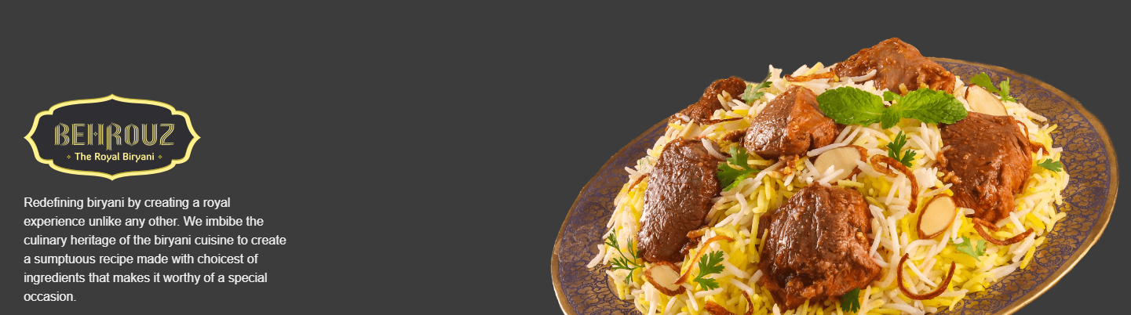
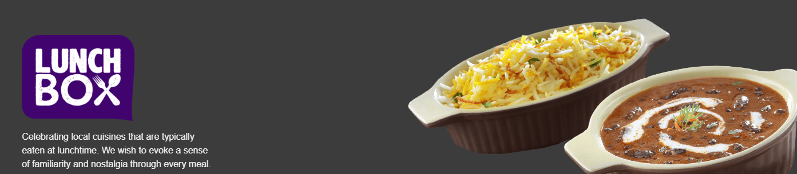
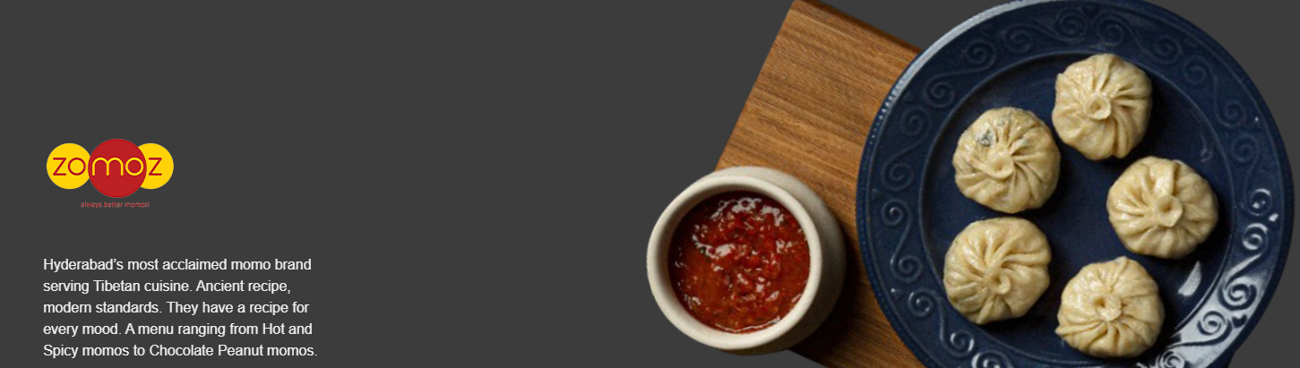
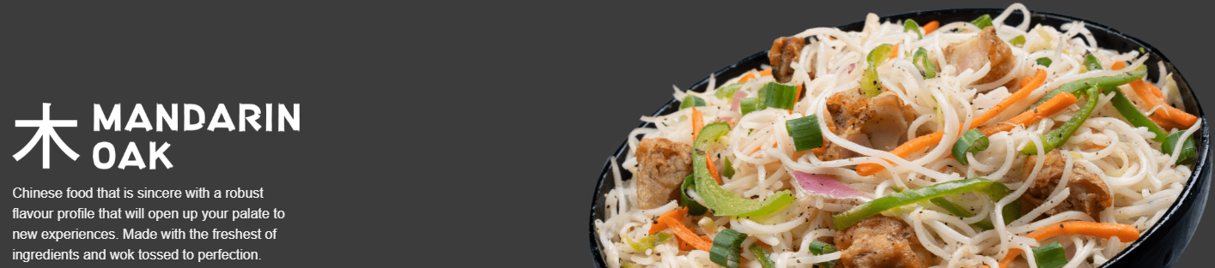
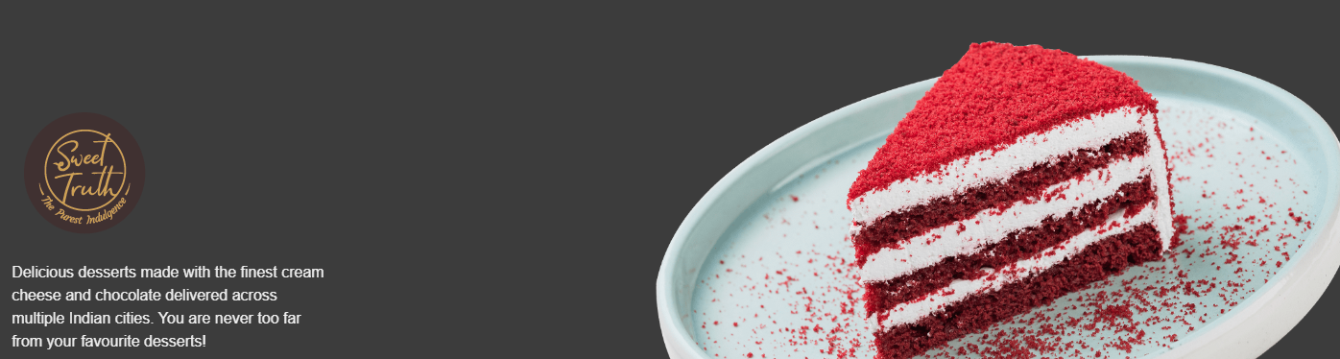
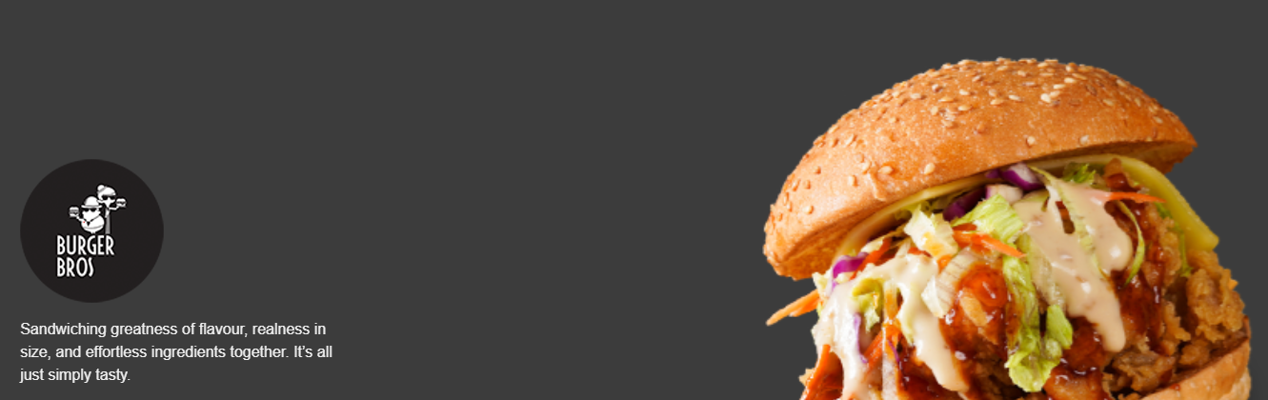

Slide 13

DONE BY :
PRASANNAKUMAR .D
MBE9 batch
calvingameing10@gmail.com

